Slide 1
Developing a Comprehensive Machine Learning System for E-Commerce: Integrating Personalized Recommendations with Demand Forecasting
KAUNAS UNIVERSITY OF TECHNOLOGY
Student: Tatenda Mawango
Supervisor: Arnas Nakrošis
30/05/2024

Slide 2
Introduction
Enhance e-commerce with personalized recommendations and demand forecasting
Benefits of the work:
Improve user experience.
Improve product management and pricing.
Address issues with cold-start problems.

Slide 3
Aim & Objectives
Aim:
Create a Machine Learning system enhancing e-commerce with personalized recommendations and demand forecasting.
Objectives:
Analyze existing e-commerce systems.
Evaluate relevant e-commerce datasets for suitability.
Design and develop a ML-based e-commerce system.
Ensure seamless integration of models.
Evaluate system performance.
KAUNAS UNIVERSITY OF TECHNOLOGY

Slide 4
Analysis
Existing Systems:
Personalized recommendations
Demand forecasting
Gaps and Opportunities:
Integration of both systems
Addressing cold-start problem
KAUNAS UNIVERSITY OF TECHNOLOGY

Slide 5
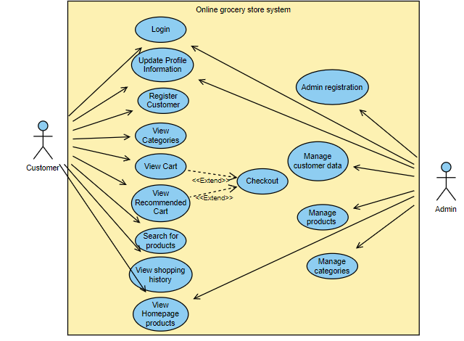
Use case Diagram
KAUNAS UNIVERSITY OF TECHNOLOGY

Slide 6
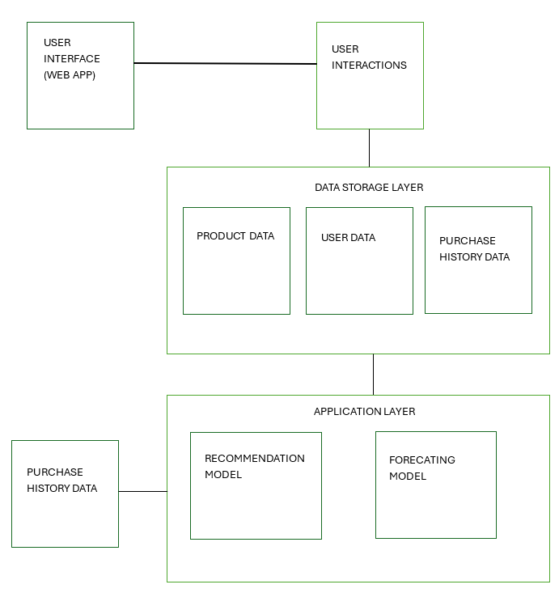
System Architecture

Slide 7
Implementation
Technologies Used:
Python, CSS, SQL
Streamlit
XGBoost, Random Forest
Development Process:
Data preprocessing
Model training and evaluation

Slide 8
Testing and Results
Evaluation Metrics:
Mean Squared Error (MSE)
R-squared (R²)
Performance:
Product Recommendation: Best model - XGBoost (MSE: 1.9992)
Demand Forecasting: Best model – Random Forest(MSE: 3.7152)

Slide 9
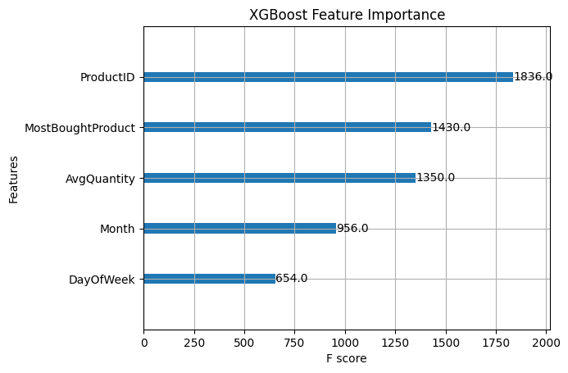
Products Recommendation System
Objective:
Enhance user experience with personalized recommendations.
Approach:
XGBoost
Features:
Engineering features: Total orders, average quantity, most bought product

Slide 10
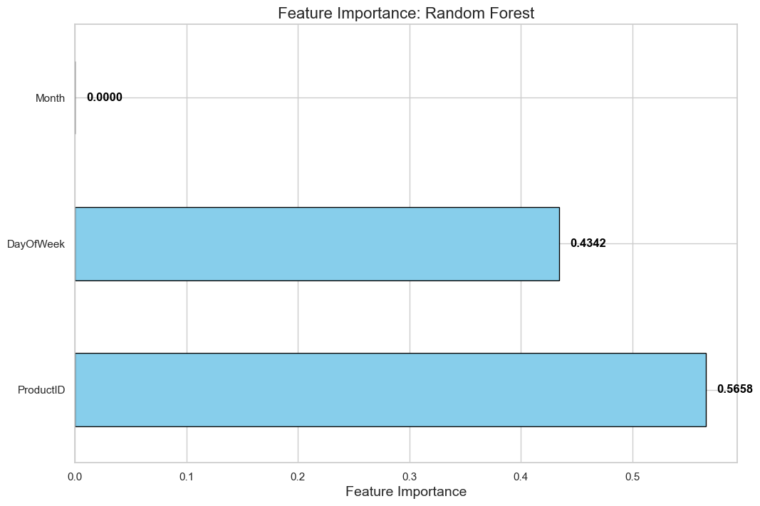
Demand Forecasting System
Objective:
Predict future product demand to optimize product inventory and pricing.
Approach:
Random Forest
Features:
Engineering features: DayOfWeek, Month

Slide 11
Challenges and Future Work
Current Limitations:
Cold-start problem
Future Enhancements:
Hybrid recommendation systems
Real-time Forecasting

Slide 12
Conclusion
After conducting a comprehensive analysis of existing system such as Yusp, Beeketing for Shopify, and WooCommerce, we manage to achieve insightful finding such how their model work. This includes simple collaborative filtering and upselling and cross-selling features with need for algorithms.
The datasets, including purchase histories and product details, were suitable for developing machine learning models, but the quality and completeness of historical data are crucial. Enhancing accuracy could be achieved by incorporating external data sources such as location information.
The e-commerce system successfully used machine learning models like XGBoost and Random Forest for personalized recommendations and demand forecasting, leveraging historical purchase data effectively. However, further improvement is necessary to address the cold start problem and integrate various data sources through hybrid models.
The system's architecture supported the integration of recommendation and forecasting models, providing a personalized yet efficient user experience. While it can handle increasing data volumes, further optimizations are needed to improve real-time processing capabilities.
Test results indicated success with machine learning techniques with product recommendation accuracy and demand forecasting. Continuous model fine-tuning and combining data sources will help maintain and improve performance and reliability.

Slide 13
Thank you

